Slide 1
Texas Tech University
College Web Tour
College Prep
Mr. Gordon
jgordon@bisdtx.org

Slide 2
Upcoming Events
hi

Slide 3
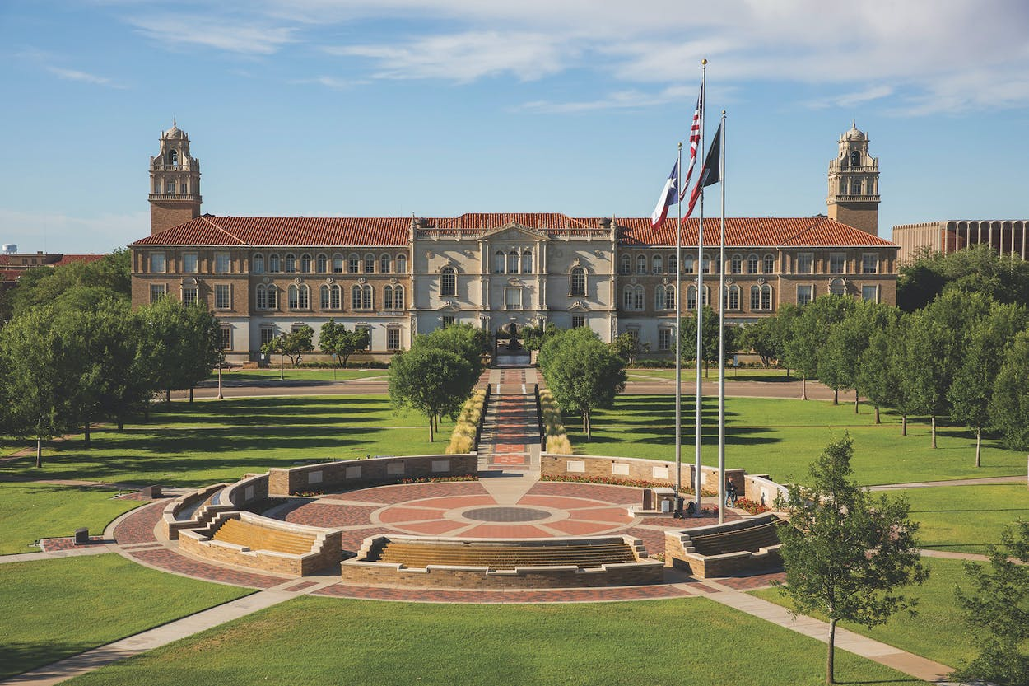
Texas Tech University Facts
Texas Tech is located in Lubbock, TX
6½ hours from CRCA
Texas Tech is a public university.
Texas Tech’s mascot is the Red Raider.
Mrs. Adams graduated from here.
hi

Slide 4
About Texas Tech University
Go to: https://www.ttu.edu/about/
Watch the video and use this page and Google to answer the following questions.
1. How many students are enrolled at Texas Tech University?
2. Does Texas Tech also offer a law school and medical school?
3. What is the current in-state tuition?
5. How many student organizations does Texas Tech have?
hi

Slide 5
College Prep Assignment
In the comments section of today’s College Prep,
answer the following question:
What is one thing you liked or disliked about
Texas Tech University?
hi

